Slide 1
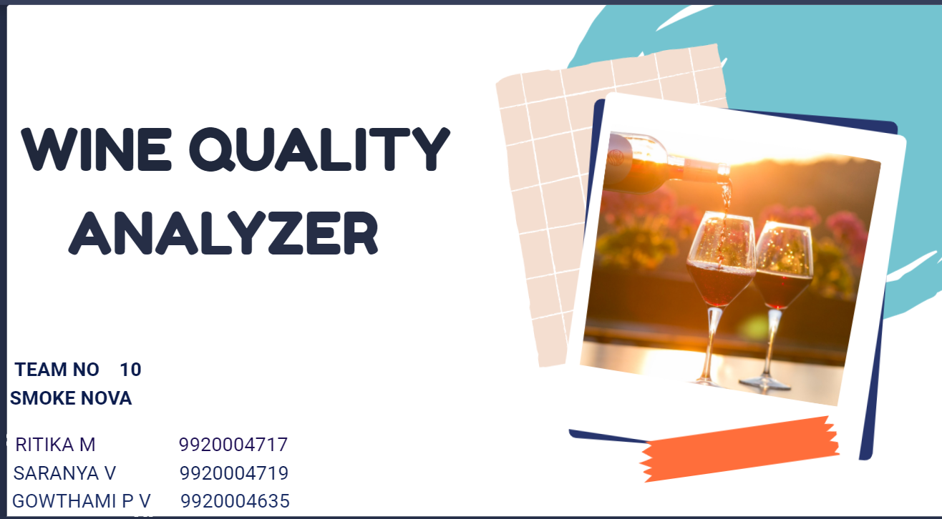

Slide 2
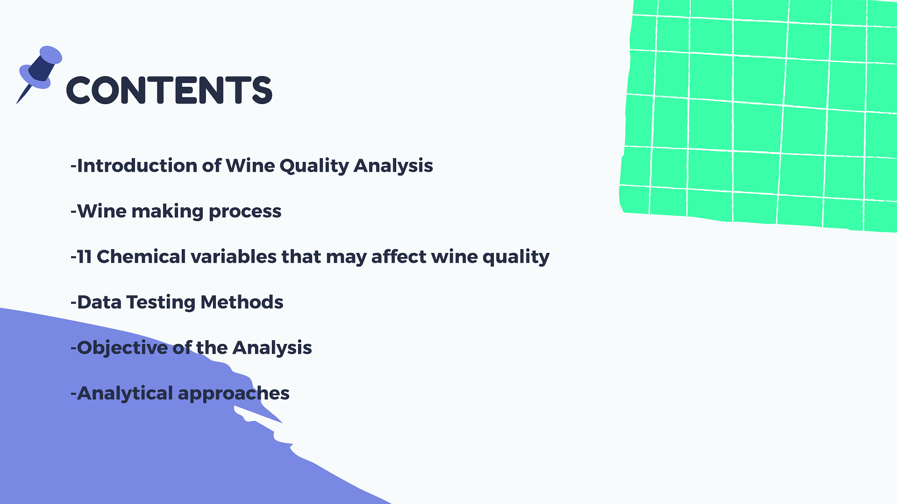

Slide 3

LITERATURE SURVEY
S.NO | Title of the project | PUBLISHER | DESCRIPTION
1 | WINE QUALITY ANALYZER | Joel Jr Rudinas (from the University of California Irvine) | Data are collected on 12 different properties of the wines one of which is Quality, based on sensory data, and the rest are on chemical properties of the wines including density, acidity, alcohol content etc. All chemical properties of wines are continuous variables. Quality is an ordinal variable with a possible ranking from 1 (worst) to 10 (best).

Slide 4
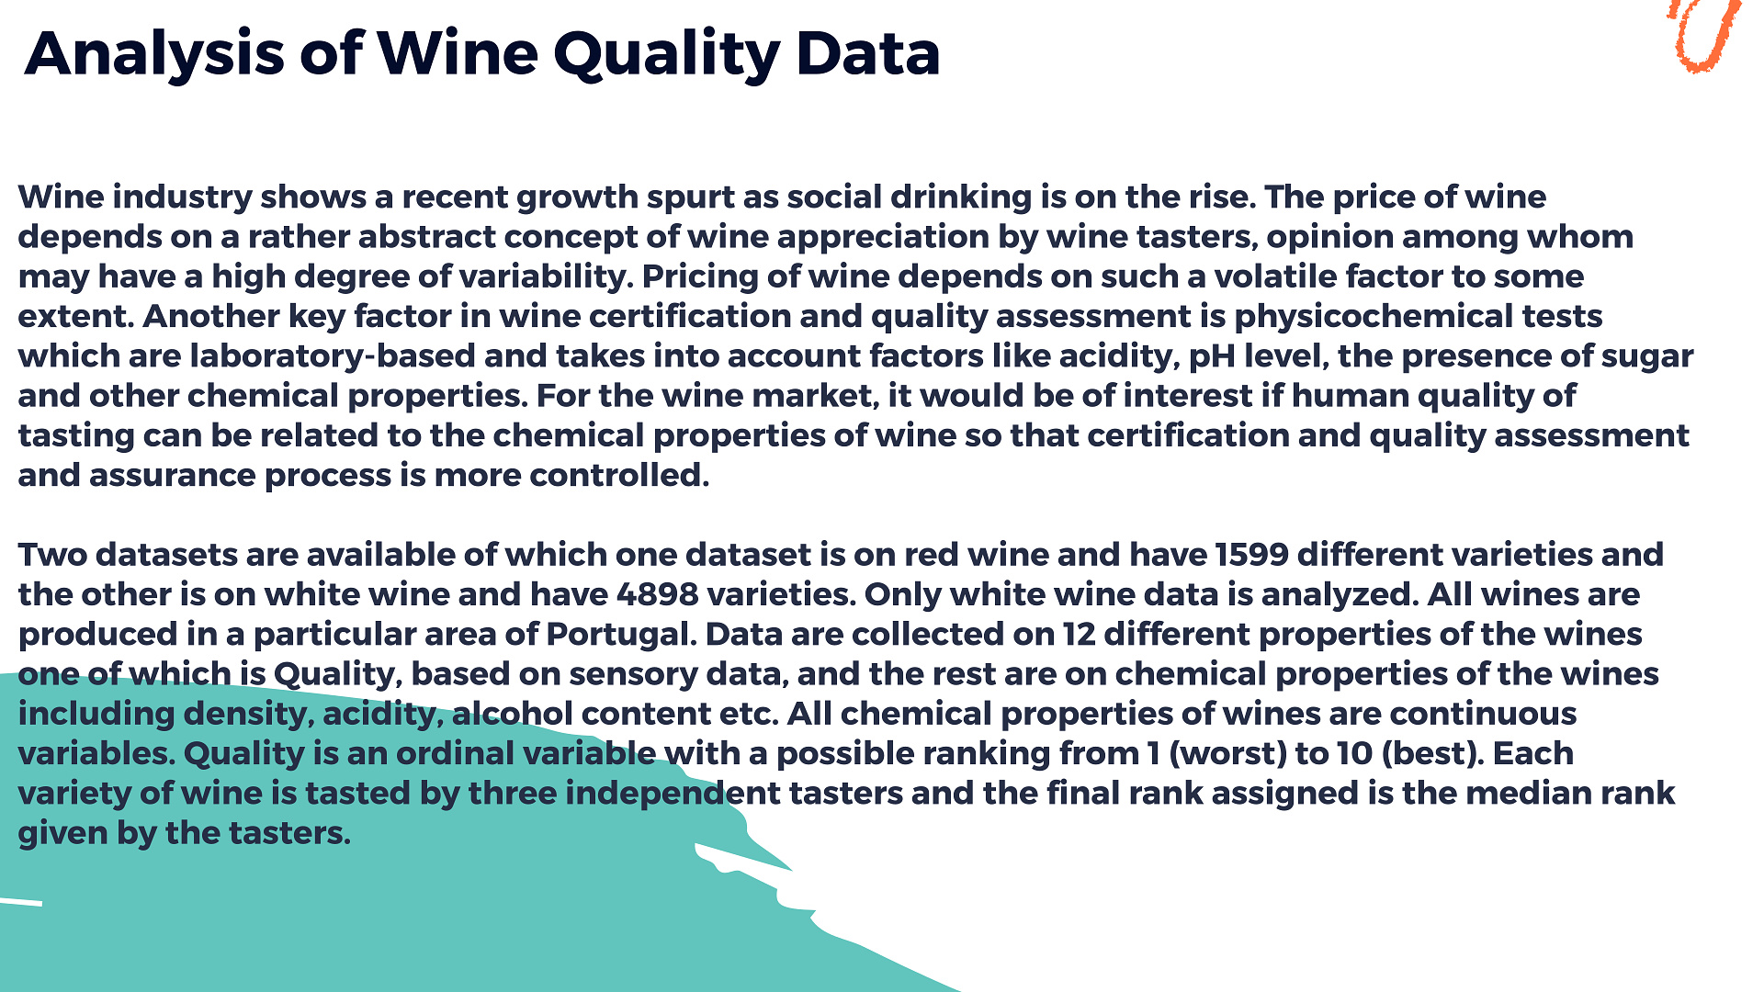
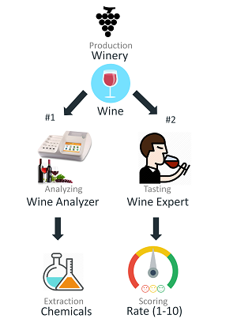

Slide 5
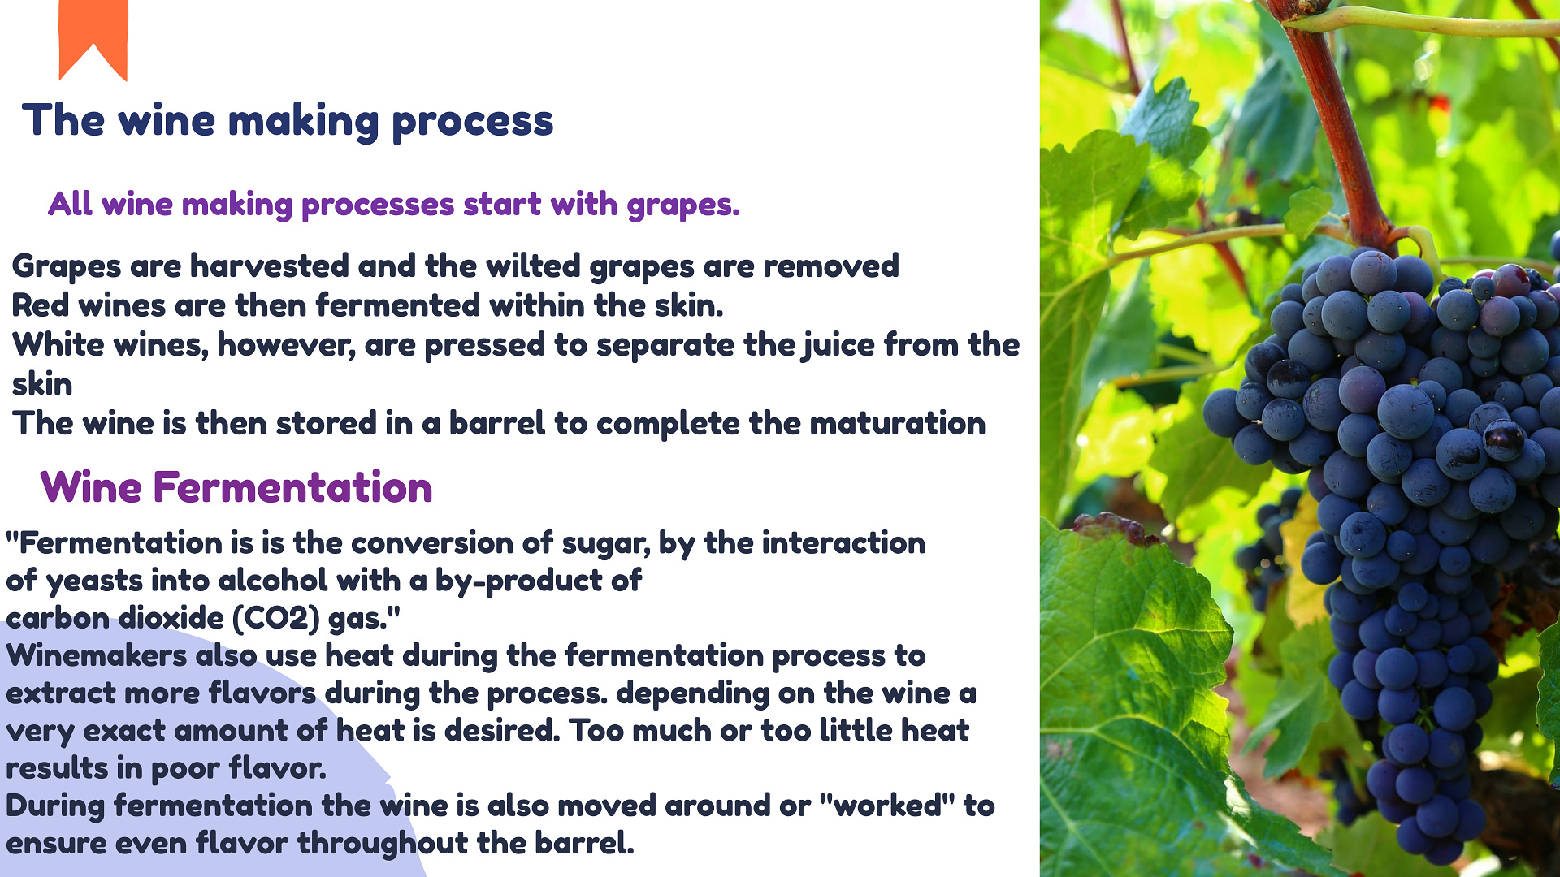

Slide 6
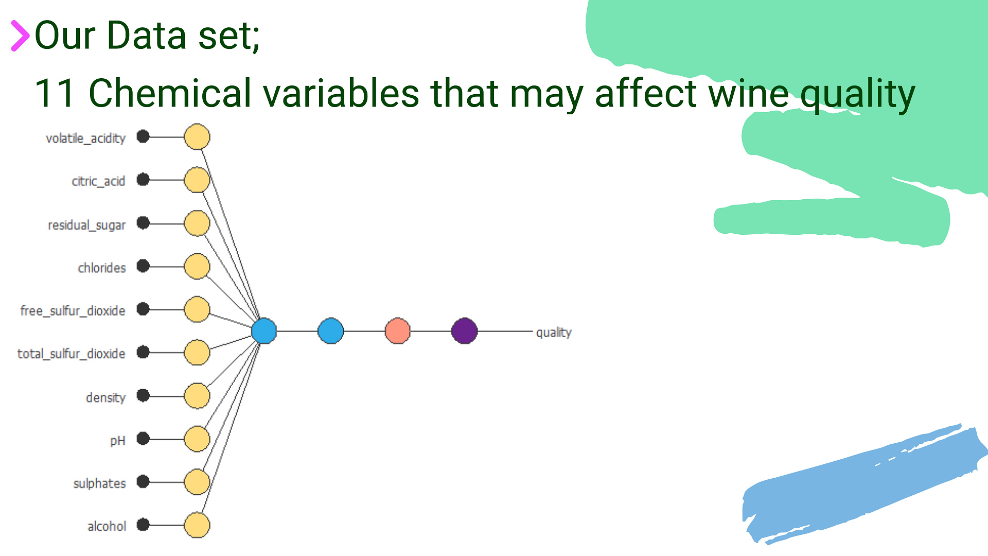

Slide 7
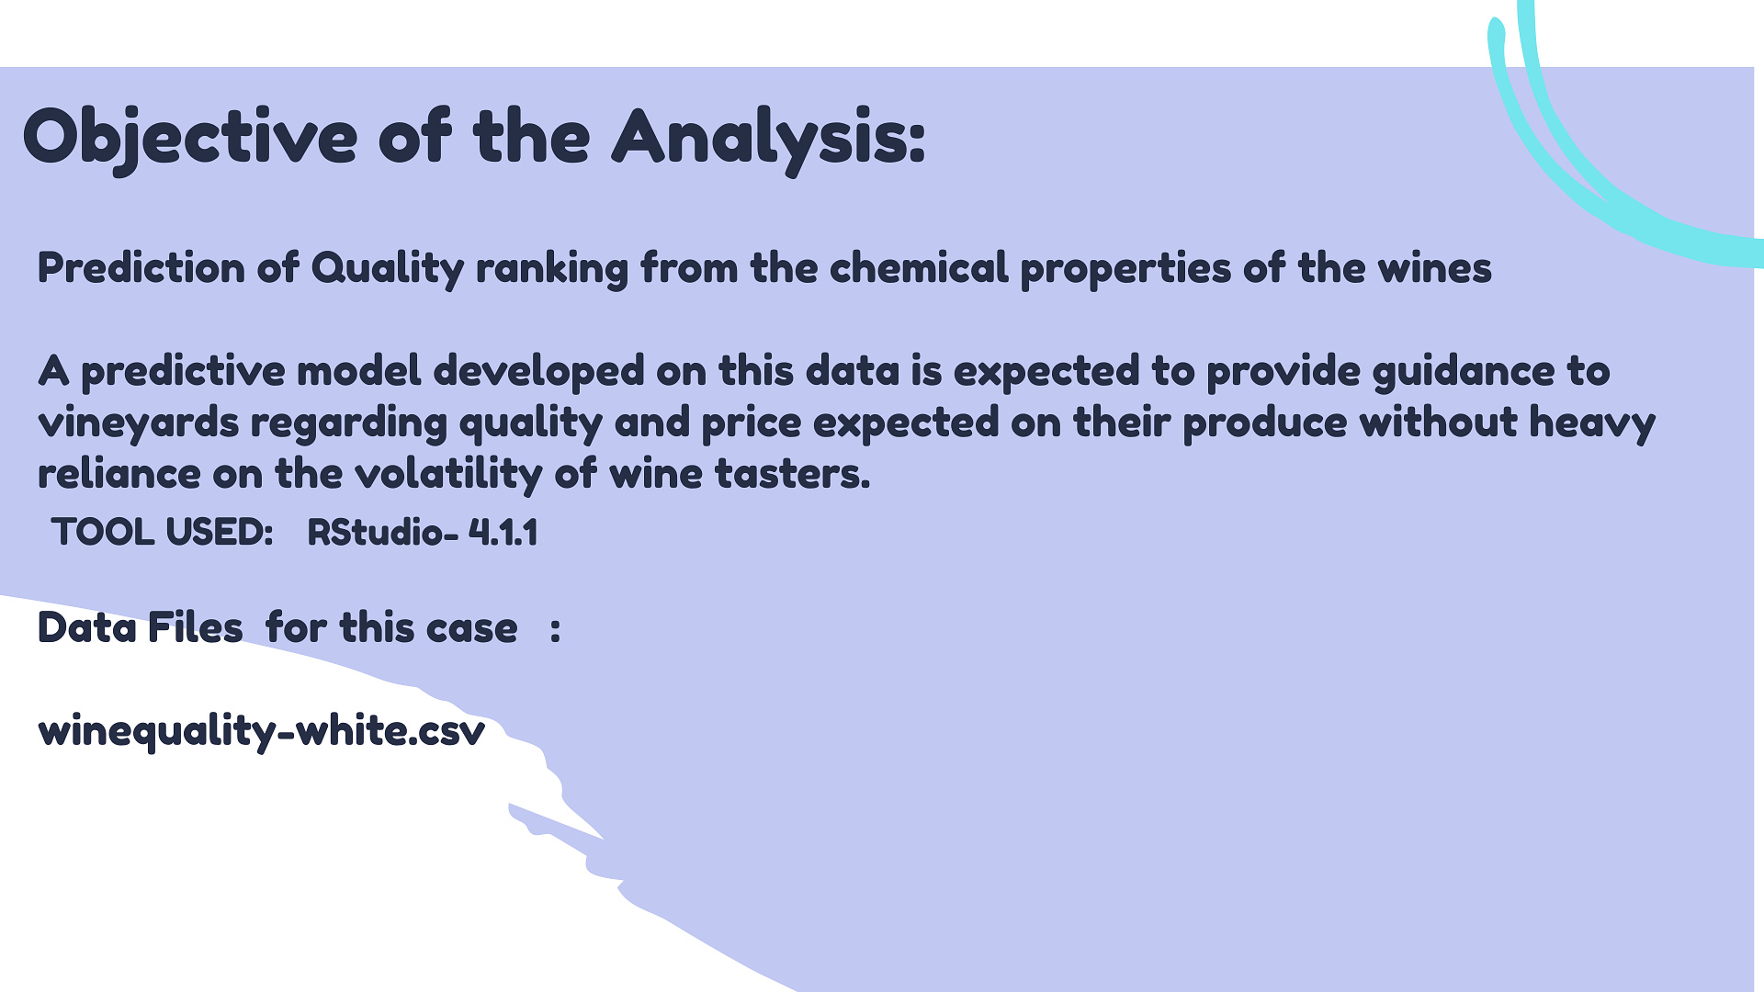
White Wine Quality Dataset
Joel Jr Rudinas
January 27, 2019

Slide 8
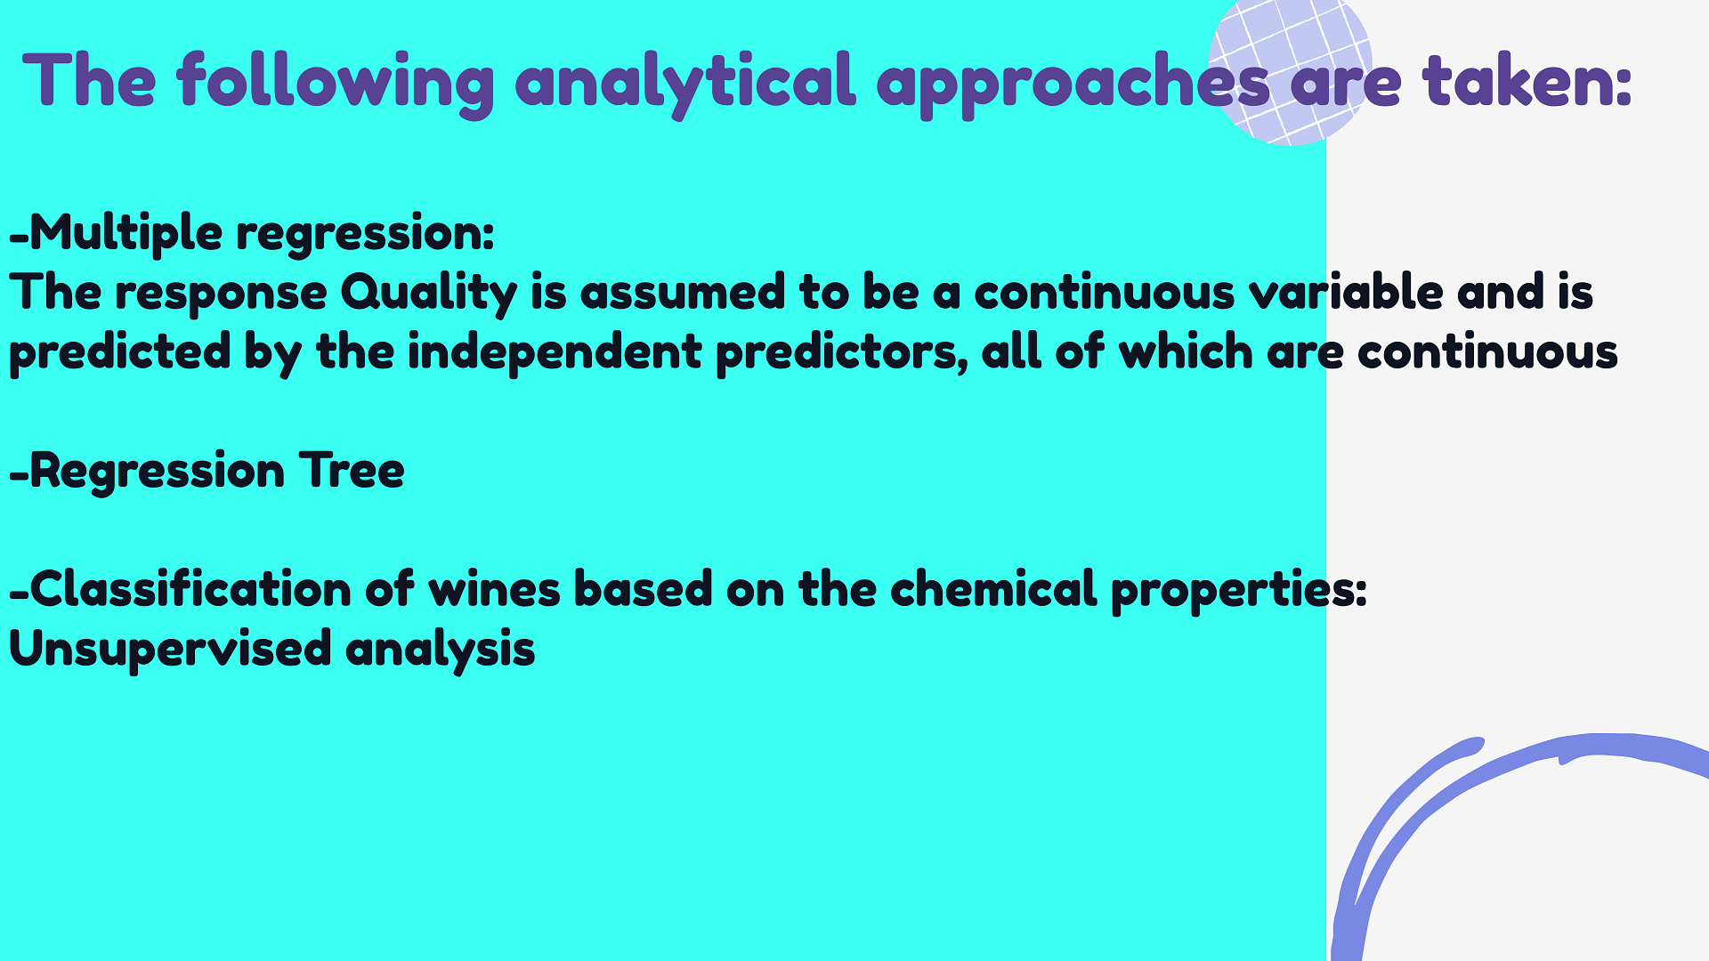

Slide 9
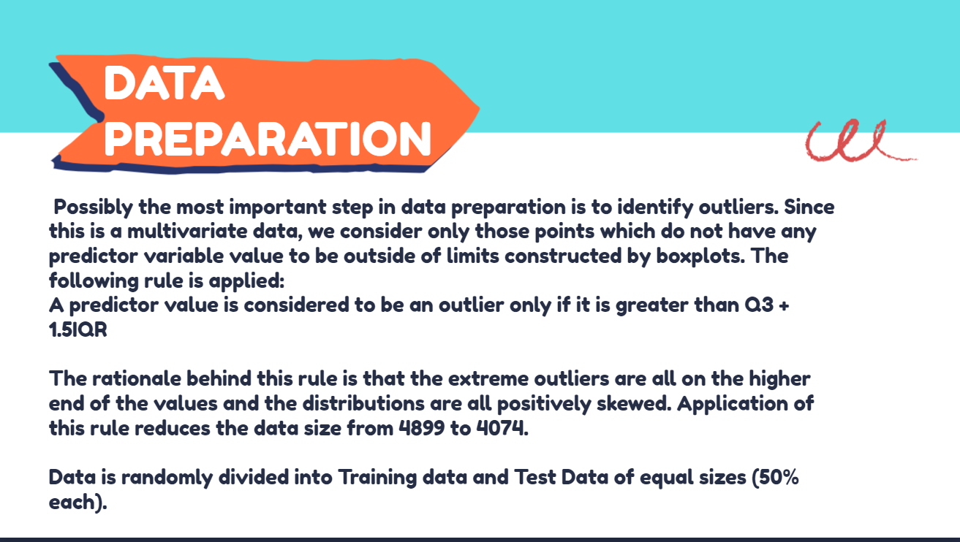

Slide 10
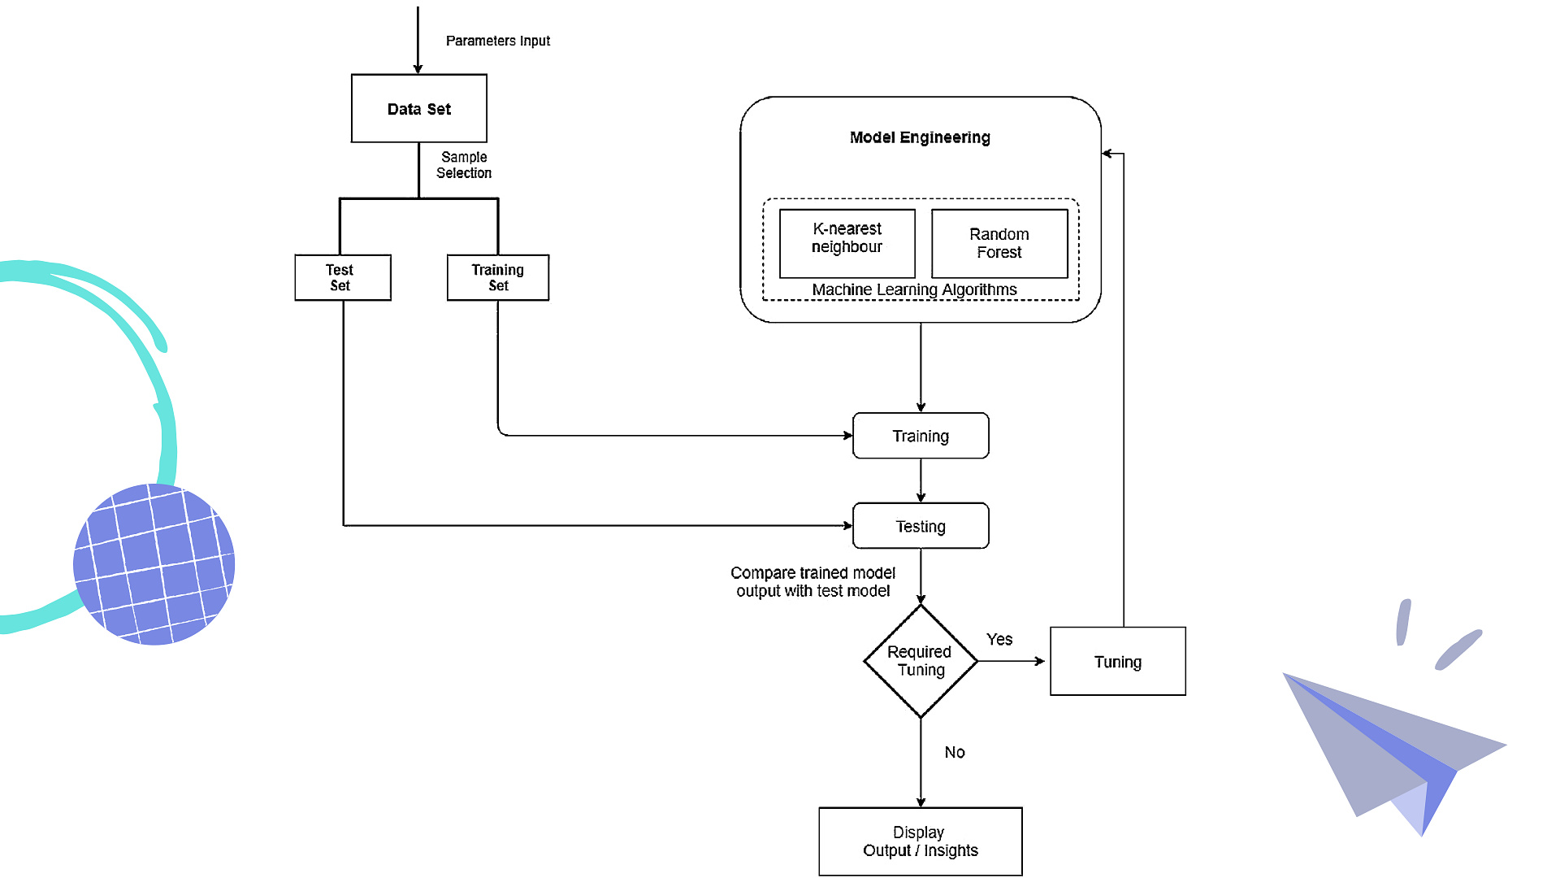

Slide 11
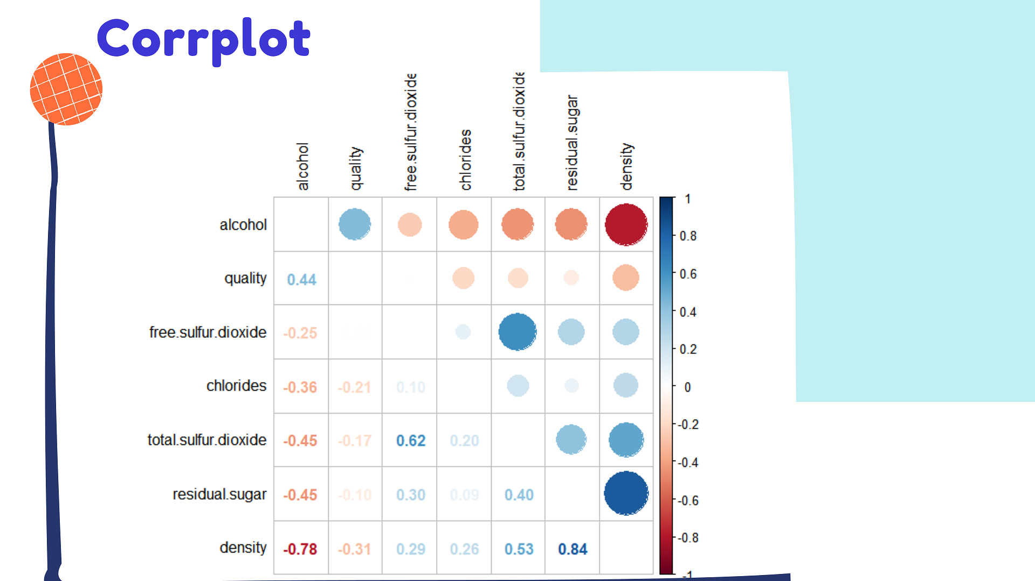
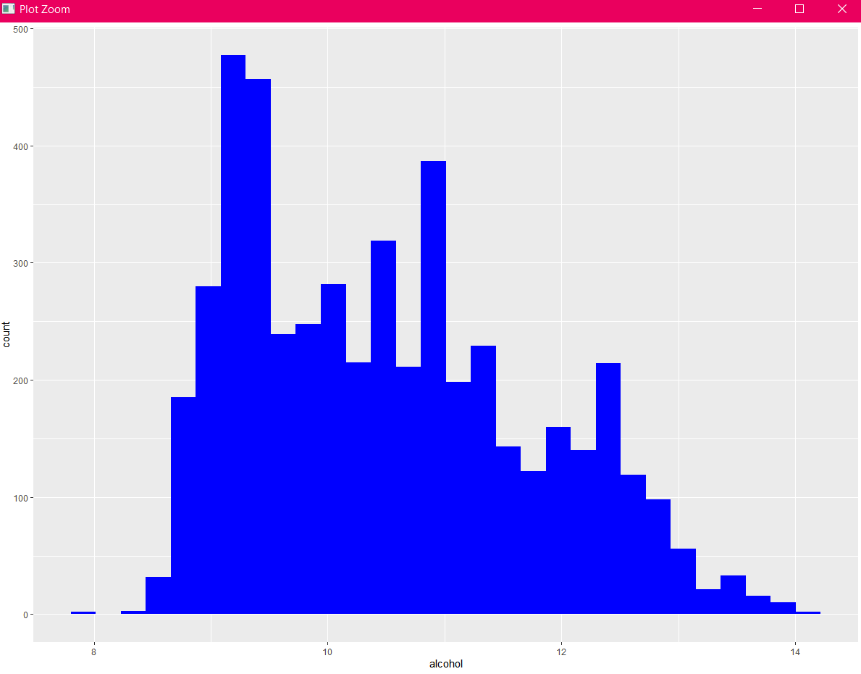
HISTOGRAM

Slide 12
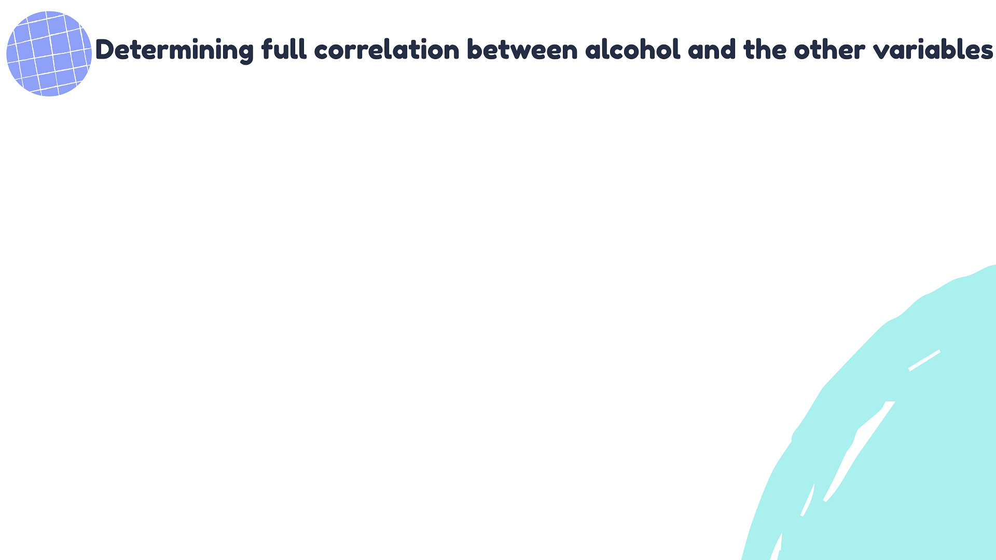
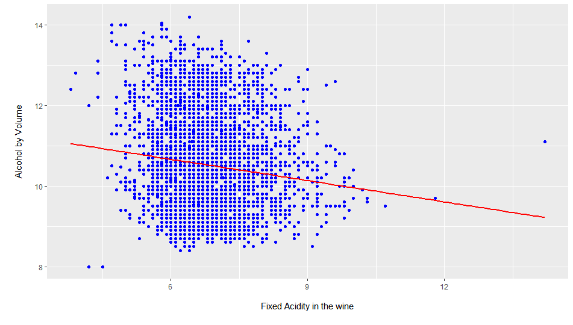
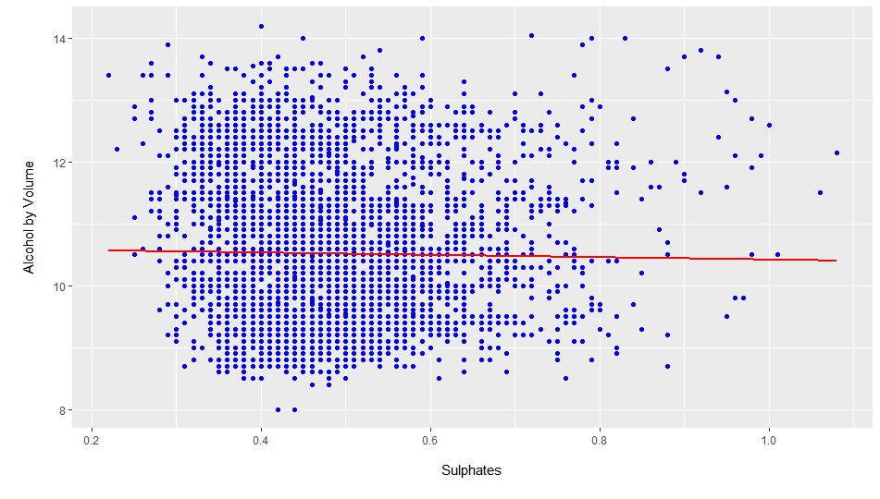
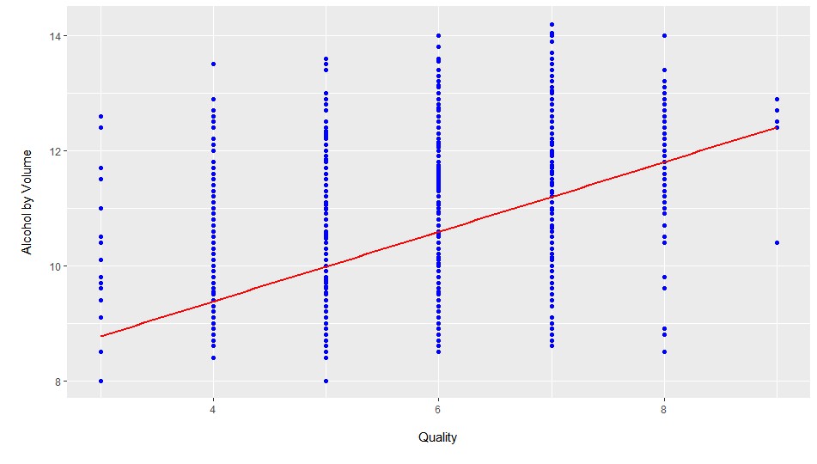
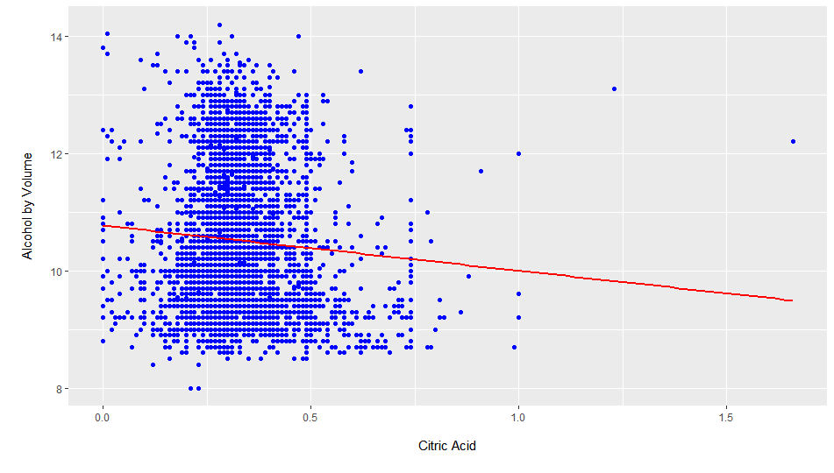
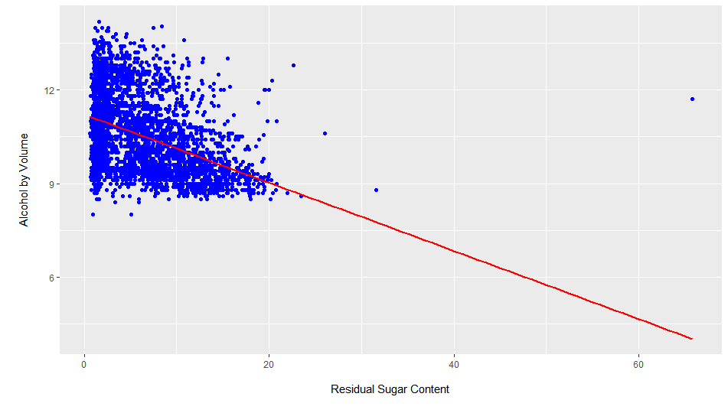
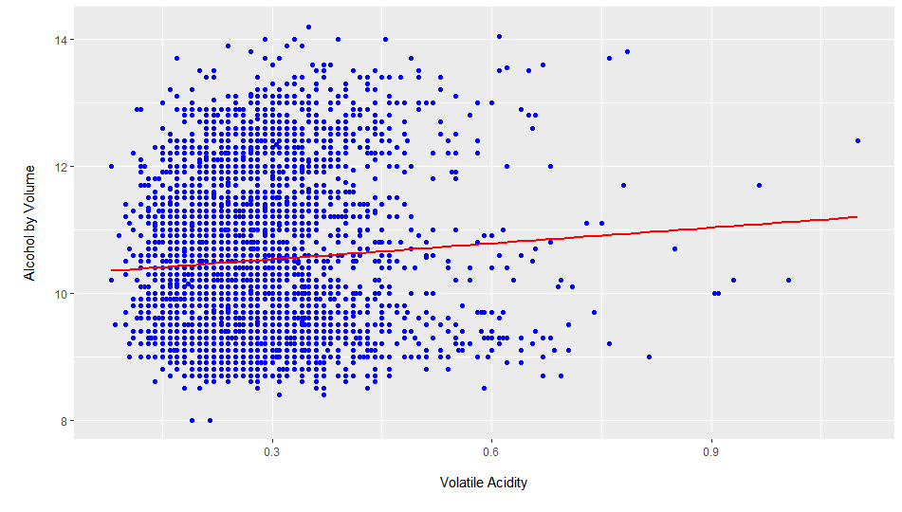

Slide 13
